Slide 1
What tracking data can tell us about serve strategy
September 24, 2022

Slide 2
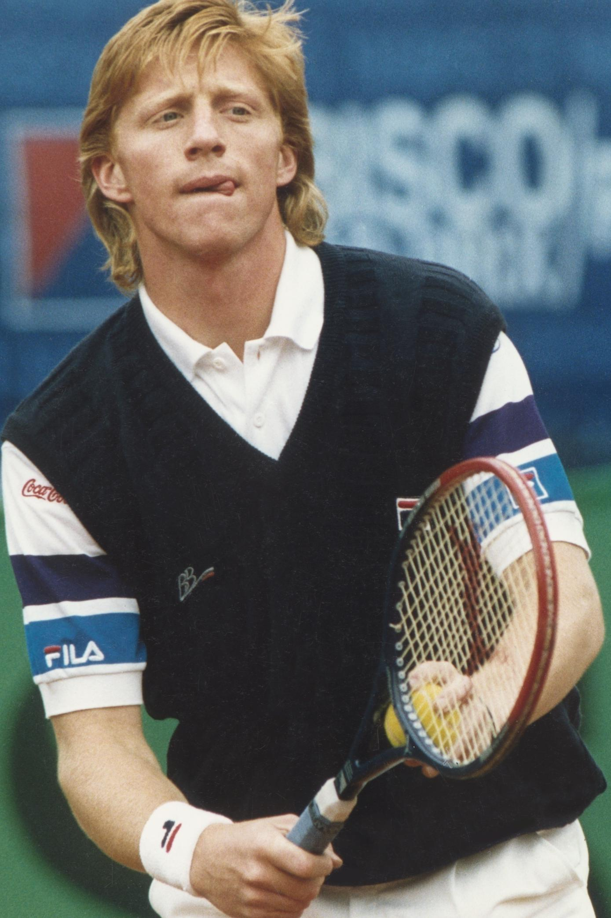
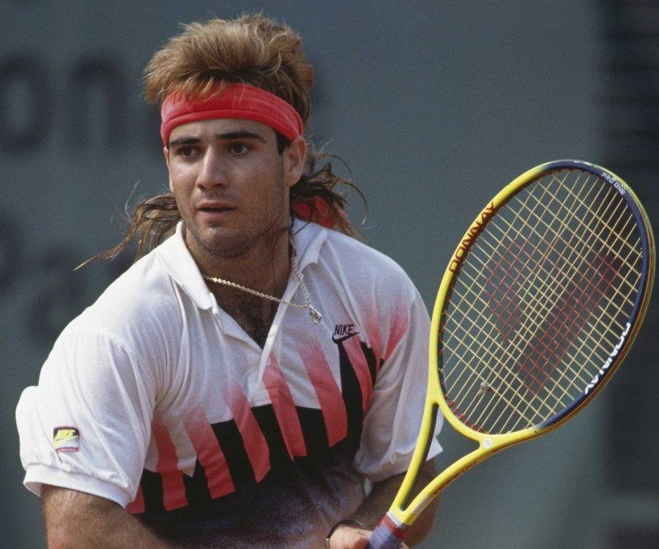
“It’s Like he’s reading my mind…”
Head-to-head record: 0-3, then 9-2

Slide 3
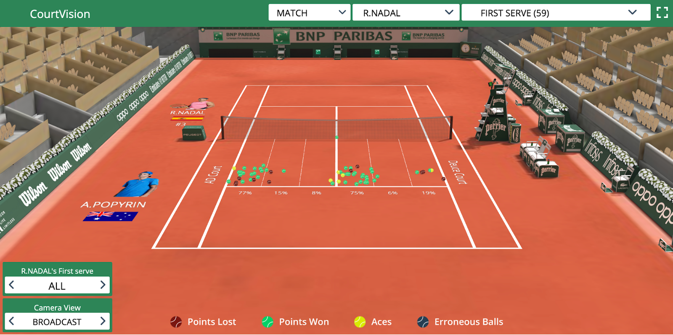
Data collection
Tournament data from 2019 and 2020 Roland Garros
 | Men’s | Women’s
# Points captured | 23, 588 | 14, 862
# Matches | 82 | 81
# Players | 74 | 78

Slide 4
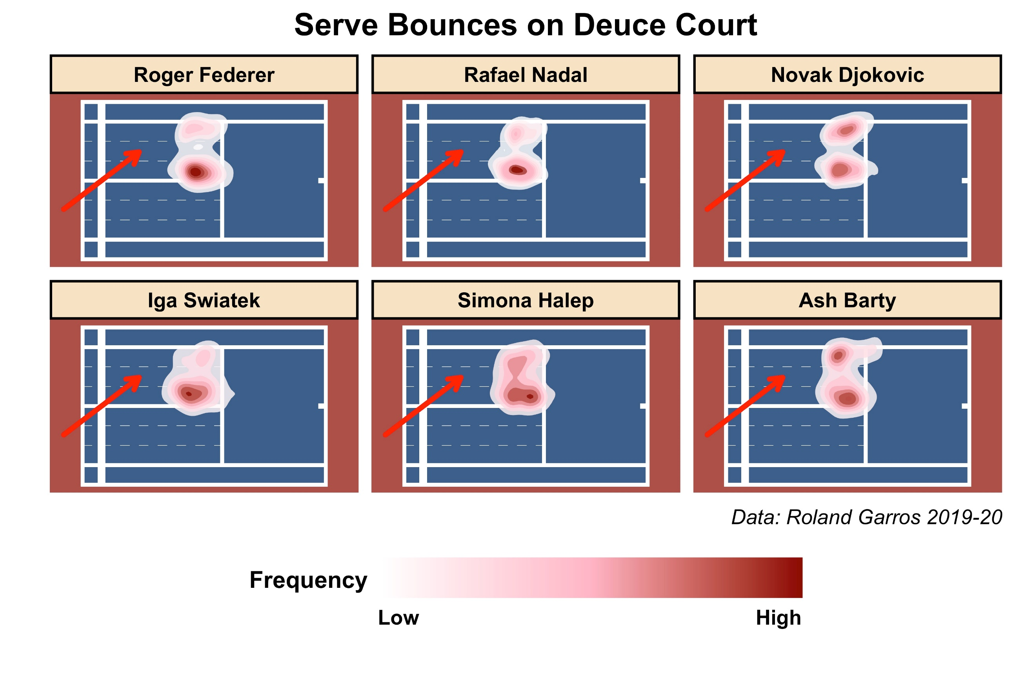
Distinct player patterns

Slide 5
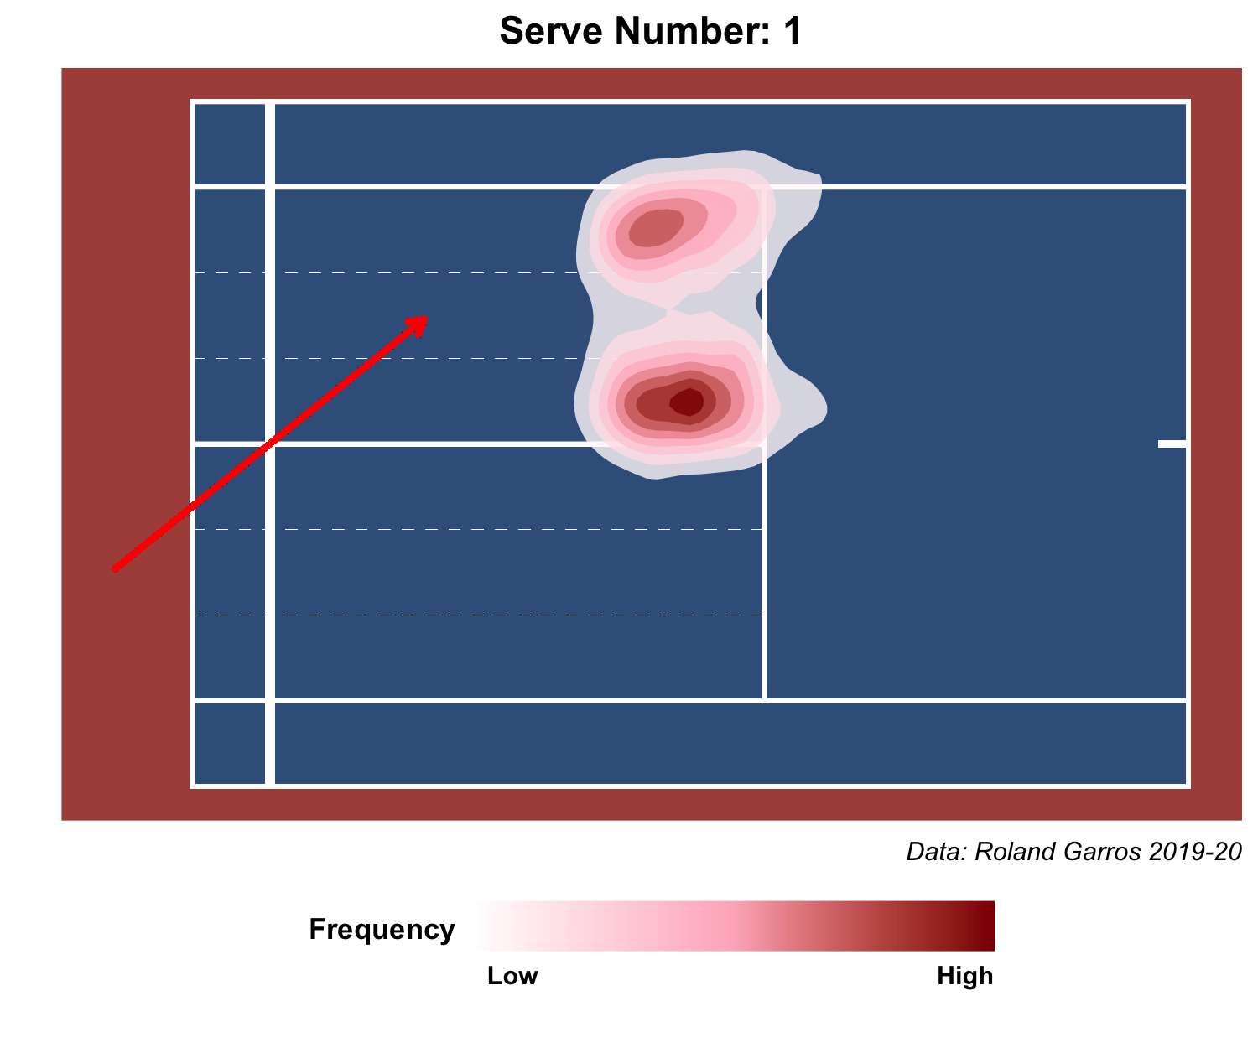
Serve Number (Managing double fault risk)

Slide 6
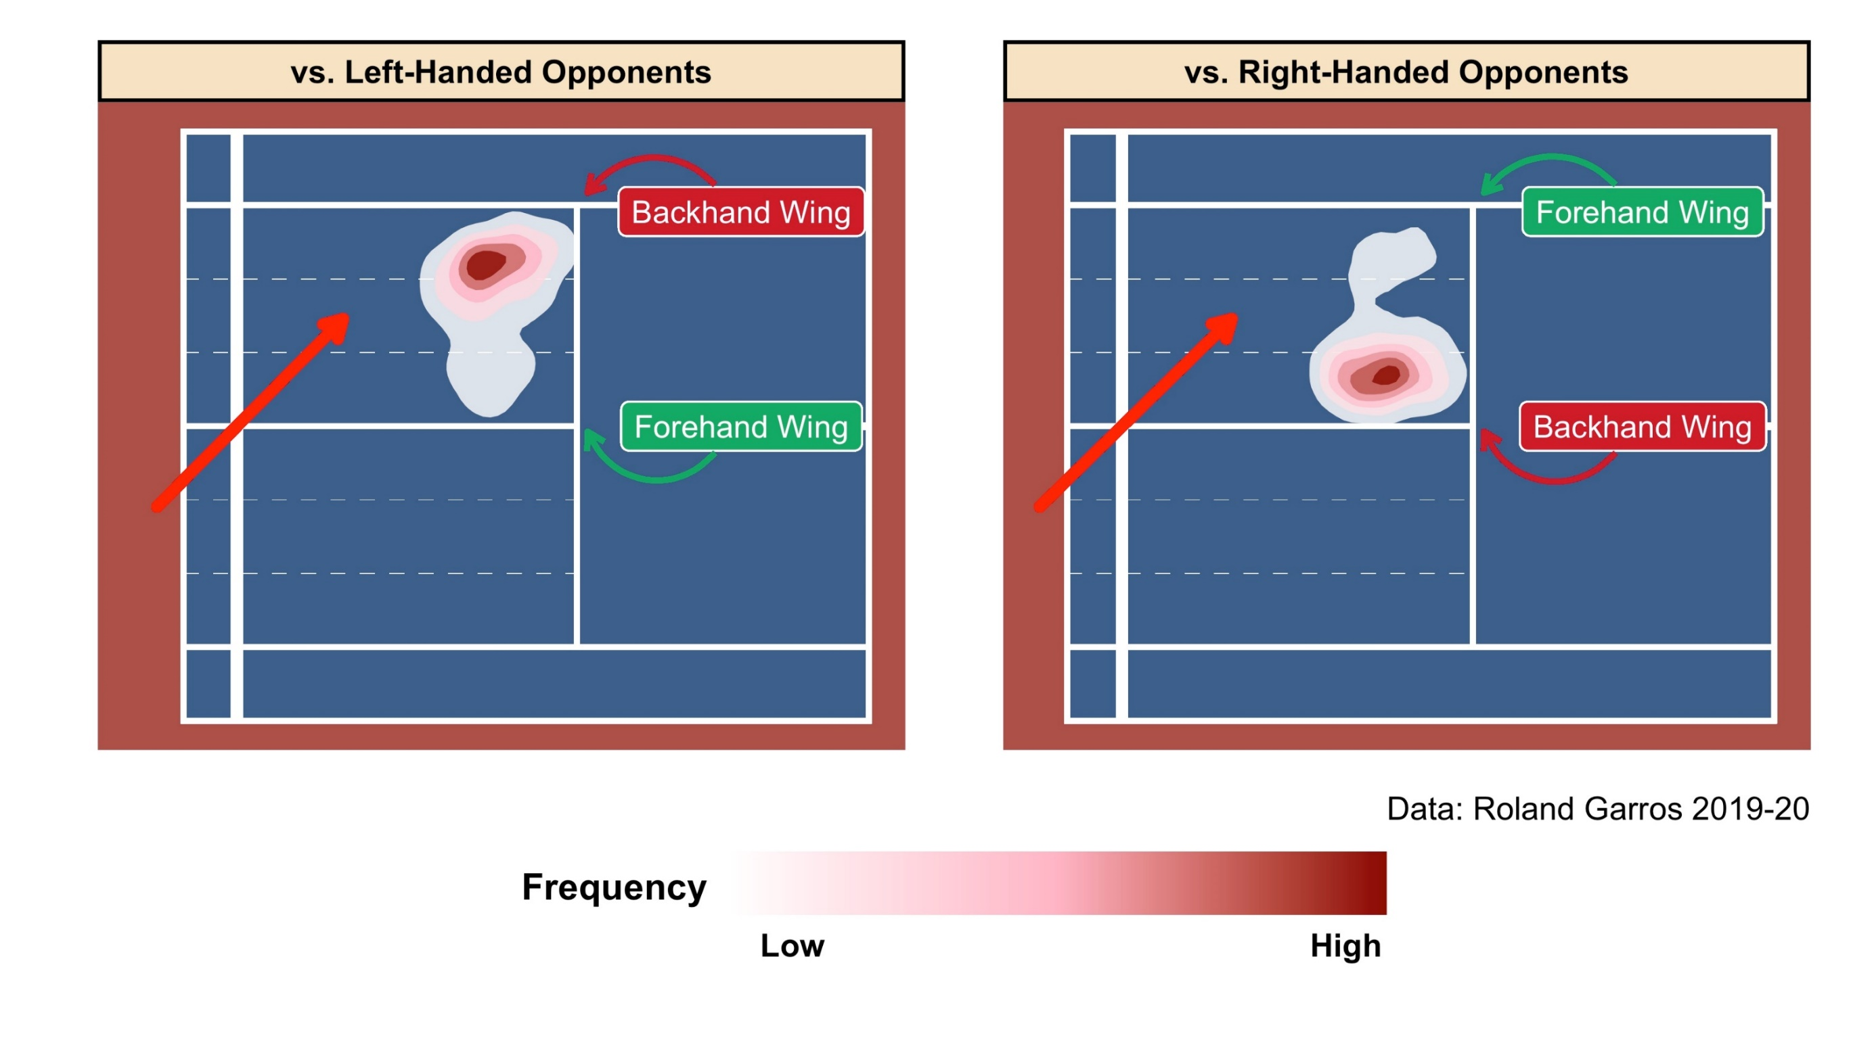
Popular Strategy: Aiming backhand (on 2nd serve)

Slide 7
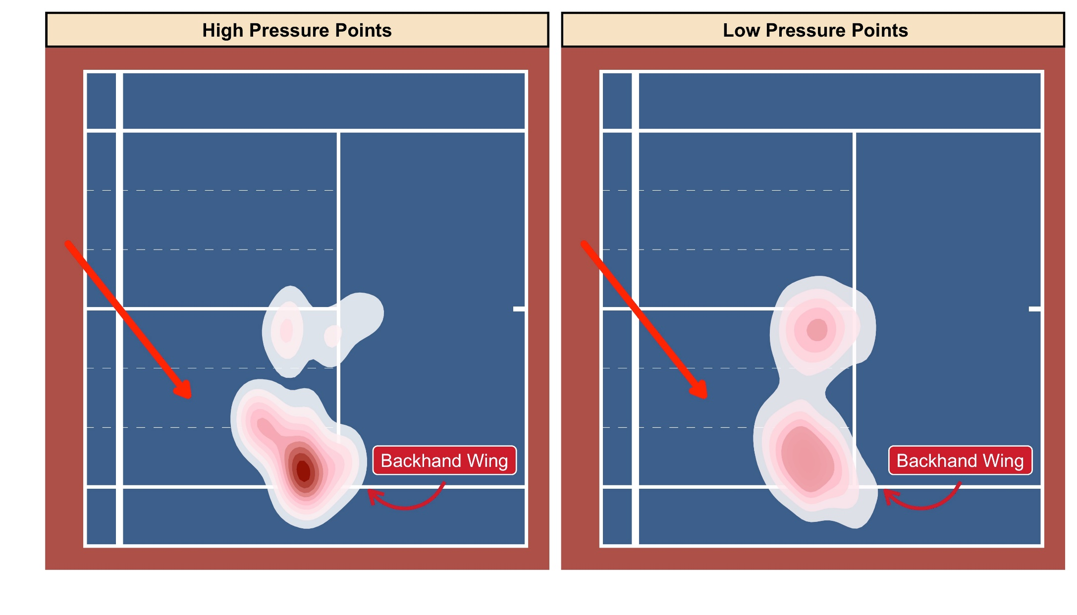
Match Pressure: Roger Federer
High Pressure Points: Break points and points approaching break (eg: 15-30)
Low Pressure Points: Everything else

Slide 8
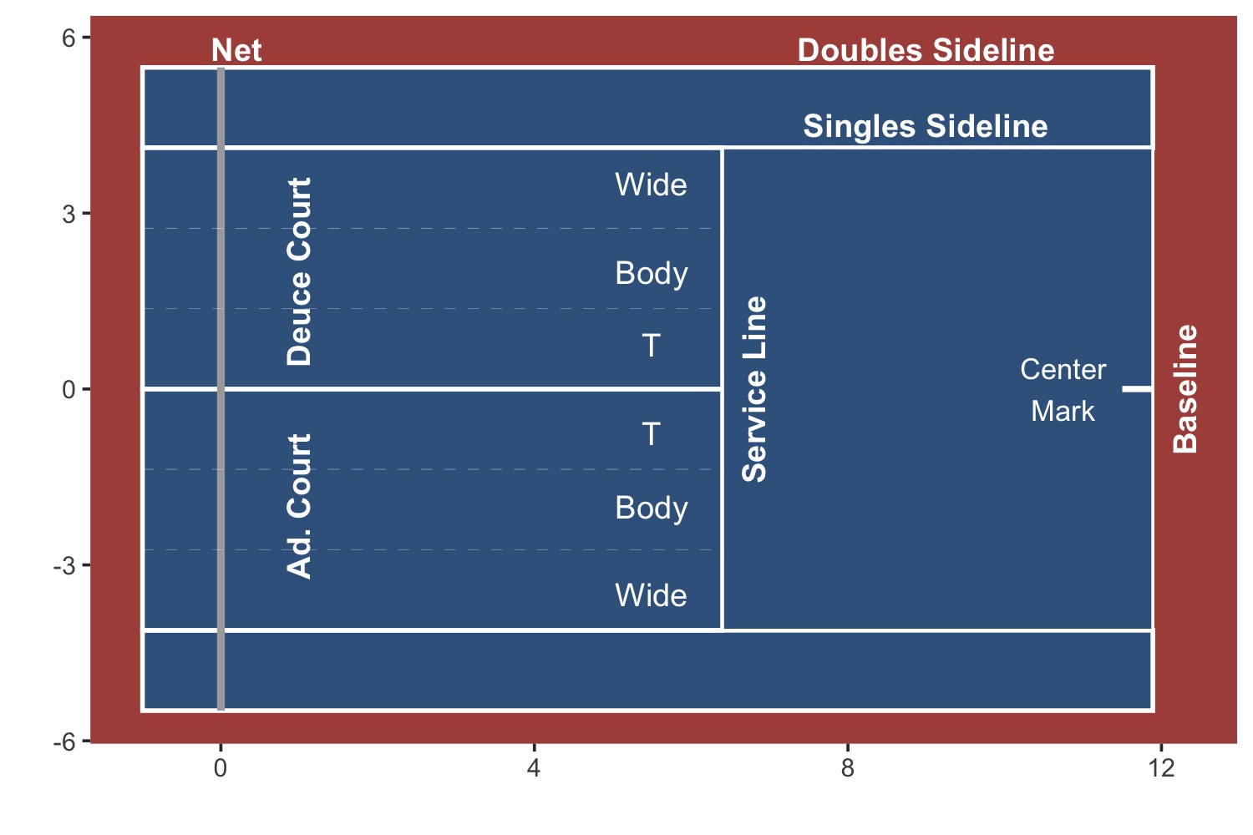
The model: Hierarchical Multinomial logit
Predict the serve direction (C=3 categories) for server i on t^{th} serve.
Two Logit equations
η_{it1} = log(π_{it1} / π_{it3} ); η_{it2} =log(π_{it2} / π_{it3} )
η_{itr} = ɑ_{ir} + X_{it}^{T} 𝜷_{r}
ɑ_{ir} are player-varying intercepts
𝜷_{r} are covariate effects

Slide 9
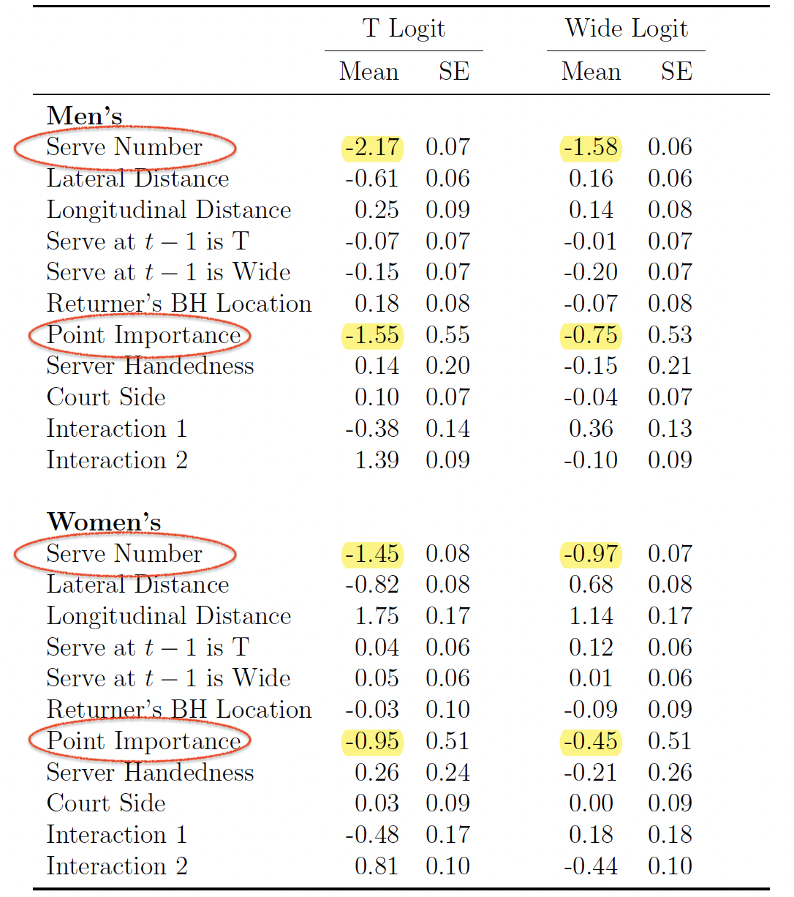
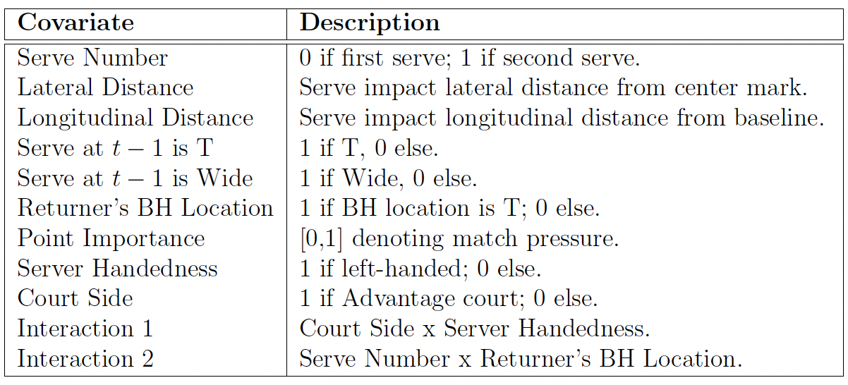
Model Results

Slide 10
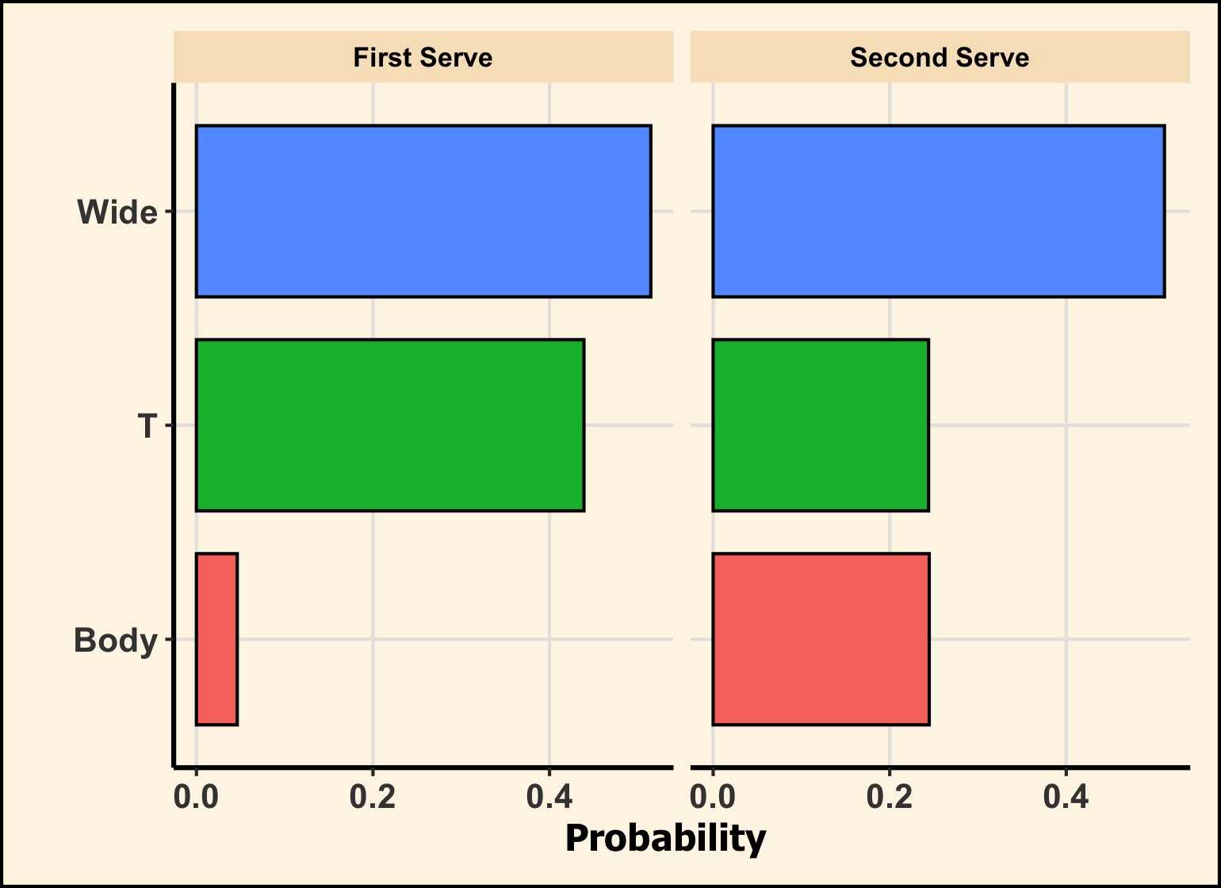
prediction
Example:
Roger Federer facing break point (Advantage court) against a right-handed opponent.

Slide 11
Thank you

Slide 12
The model: Multinomial logit
Predict the serve direction (C=3 categories) for server i on t^{th} serve.
Two Logit equations
η_{it1} = log(π_{it1} / π_{it3} ); η_{it2} =log(π_{it2} / π_{it3} )
η_{itr} = ɑ_{ir} + X_{it}^{T} 𝜷_{r}
(ɑ_{i1} , … , ɑ_{ir}) ~ N_{C-1}((ɑ₁ , … , ɑ_{C-1}) , 𝚺_{ɑi});
(ɑ₁ , … , ɑ_{C-1}) ~ N_{C-1}(0 , 𝞶I_{C-1})
(𝜷₁ , … , 𝜷_{p}) ~ N_{p}(0 , 𝞶_{𝜷}I_{p})

Slide 13
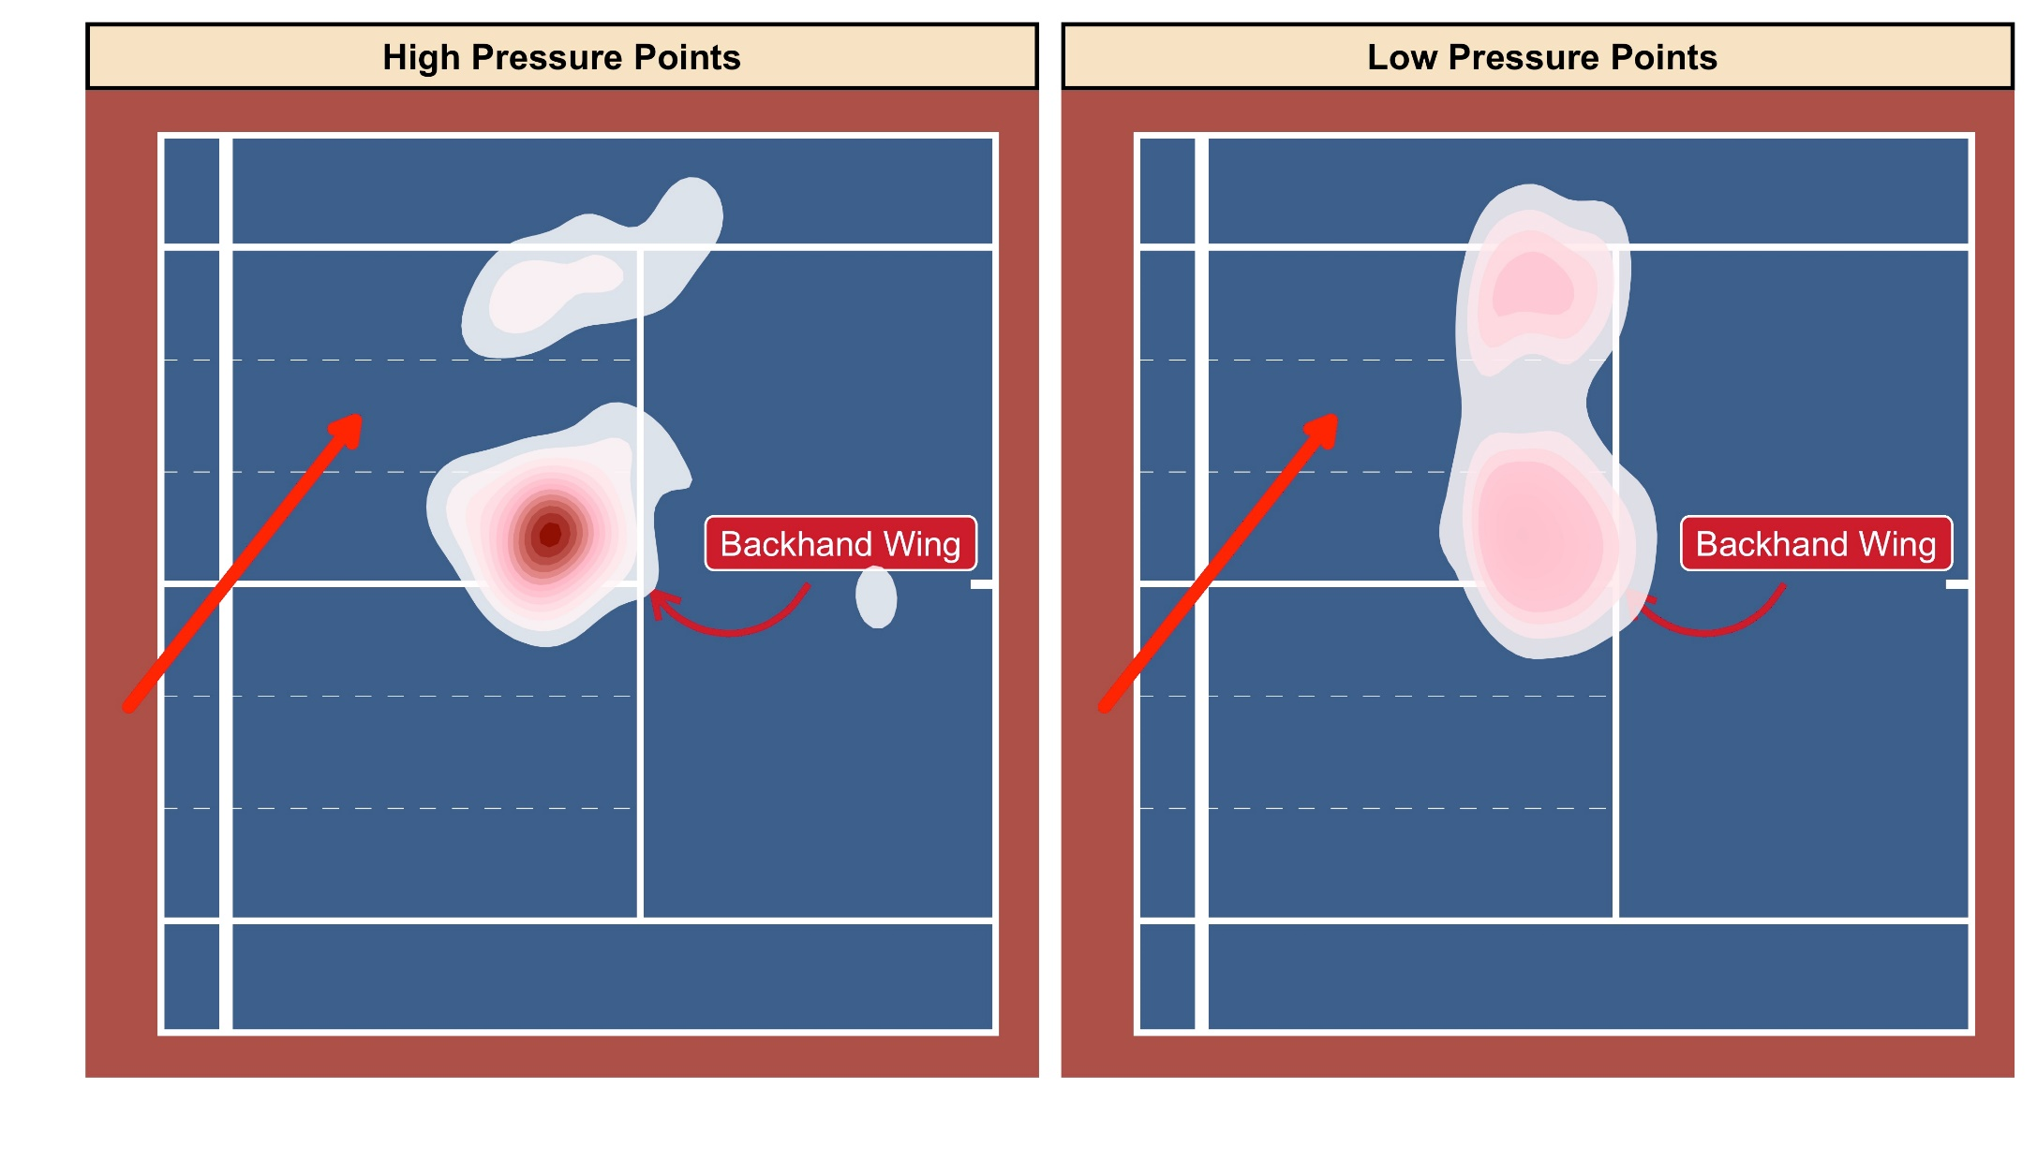
Match Pressure: Roger Federer
High Pressure Points: Break points and points approaching break (eg: 15-30)
Low Pressure Points: Everything else

Slide 14
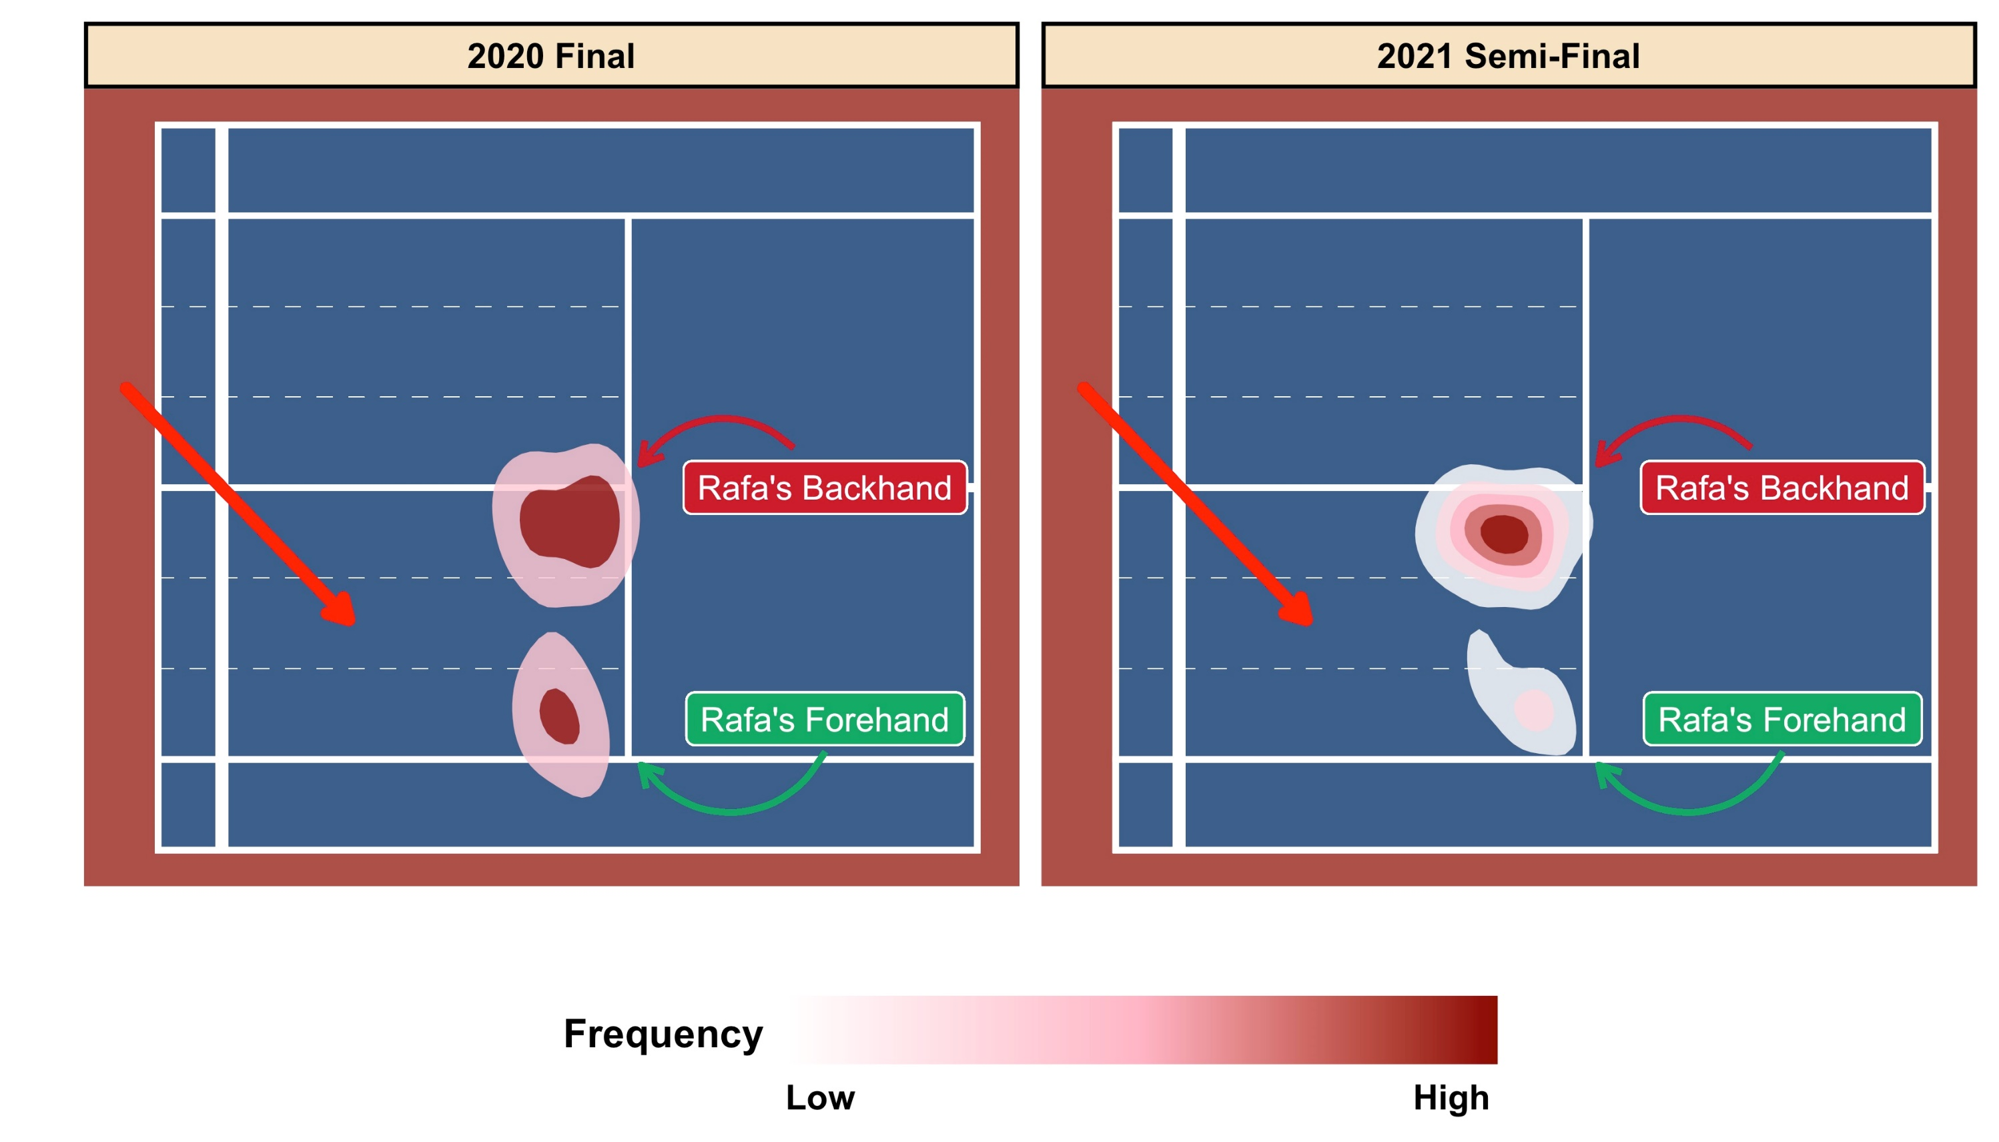
Case study: Djokovic vs. Nadal

Slide 15
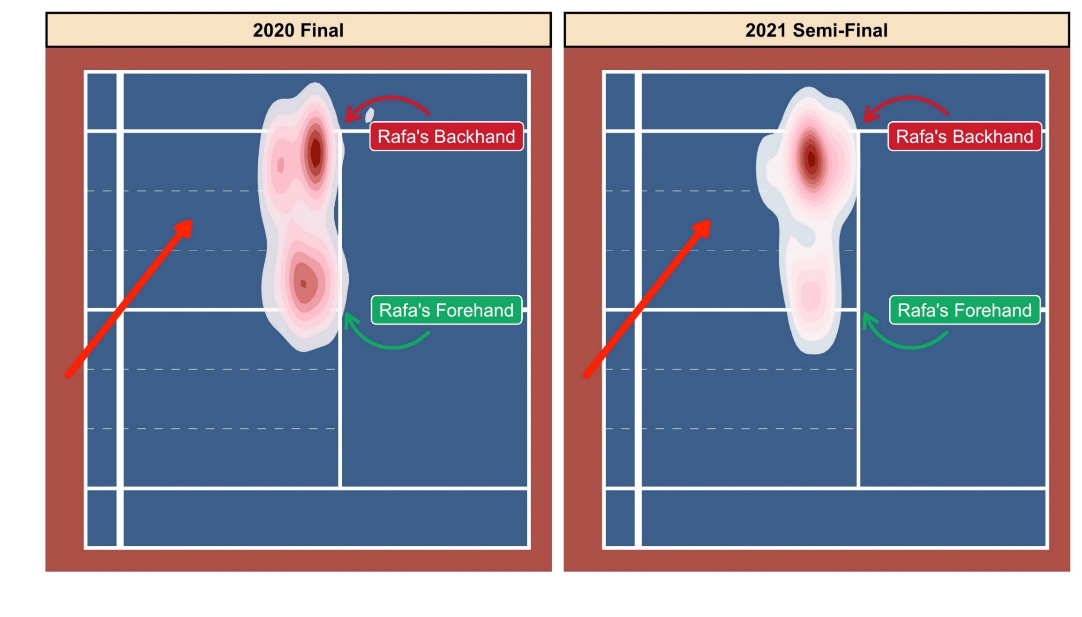
Case study: Djokovic vs. Nadal

